Slide 1

Super-mart grocery sales

Slide 2
agenda
Problem Statement – Predict Sales and Profit from retail data to support
business decisions.
Data Exploration & Cleaning – Performed EDA, handled outliers, and
engineered key features.
Model Development – Built multiple ML models and finalized a
Stacked Ensemble (RF + XGBoost).
Evaluation – Measured accuracy (R², MAE, MSE) and generated
PDF reports with residual plots.
Deployment – Created an interactive Streamlit app for real-time
Sales & Profit prediction.

Slide 3

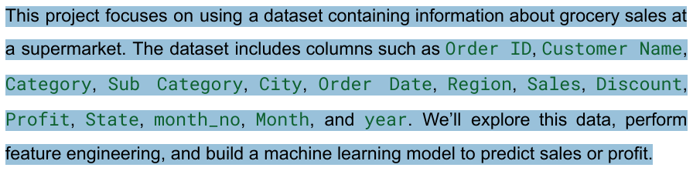
Problem statement
SUPERMART GROCERY SALES
MACHINE LEARNING PROJECT

Slide 4
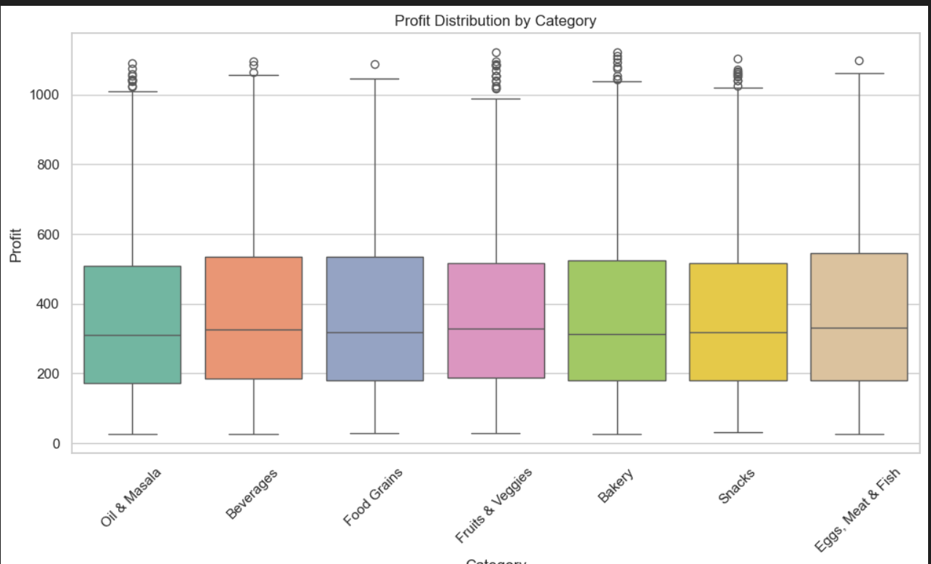
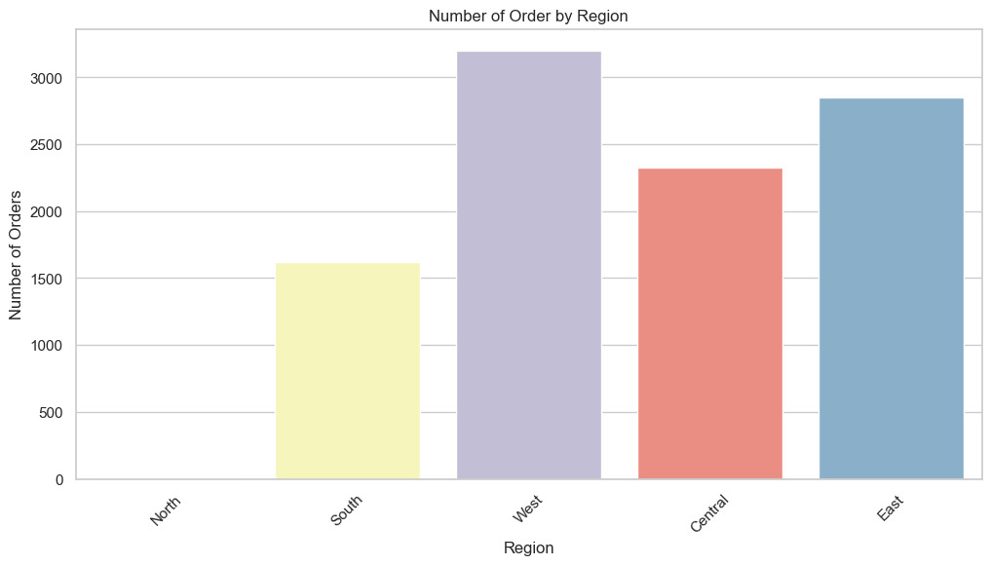
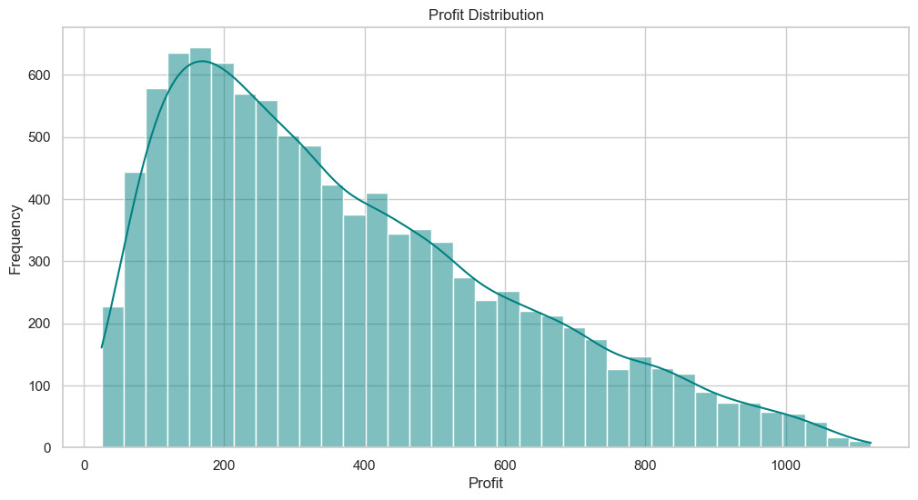
EDA
The **West region** has the highest number of orders, followed by the **East** and **Central** regions. The **South region** shows the lowest order count, indicating a potential opportunity for growth or the need for better outreach in that area
The profit distribution is **right-skewed**, with most transactions earning a profit between **100–300 units**. As profit increases, the frequency decreases, indicating that **high-profit orders are less common**, while **moderate-profit orders dominate** overall sales.
All categories have a similar median profit, generally between 300–350 units.
Eggs, Meat & Fish shows a slightly higher median compared to others.

Slide 5
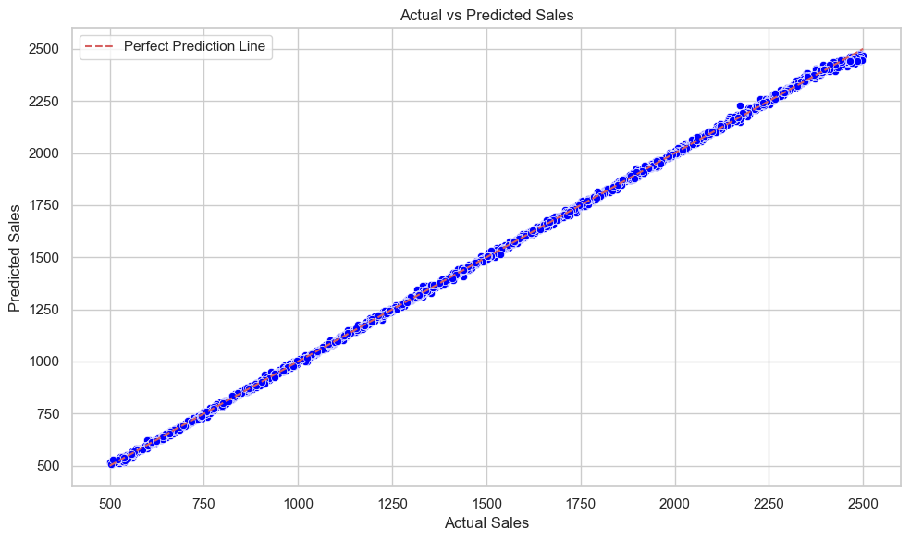
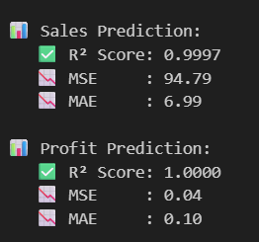
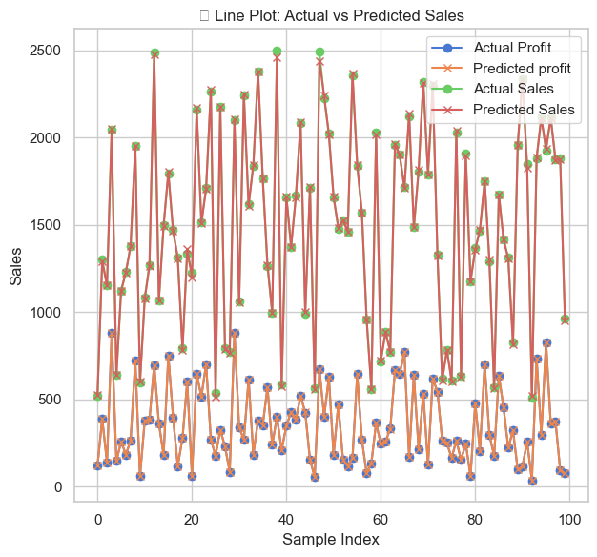
MODEL BUILDING

Slide 6
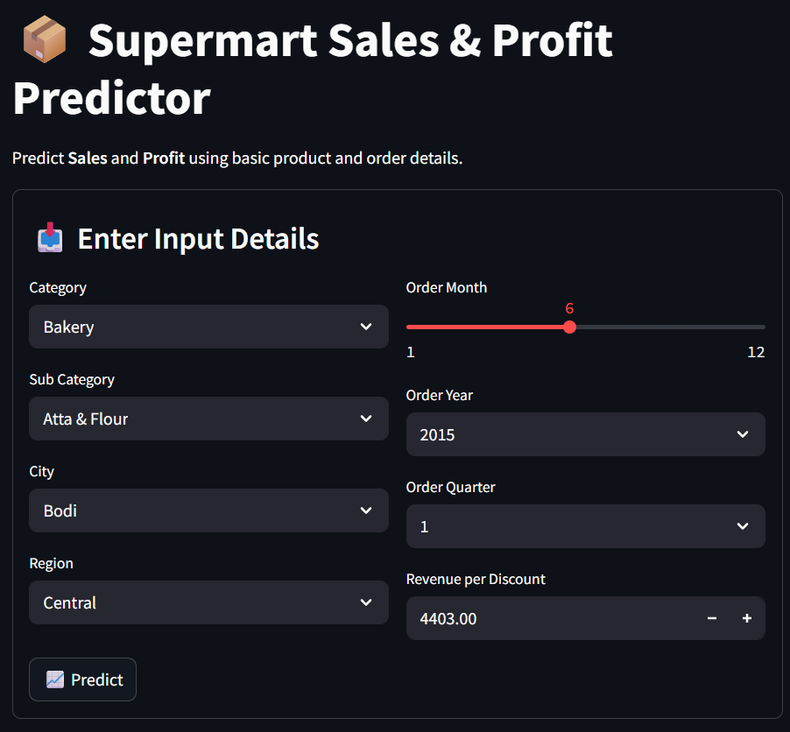
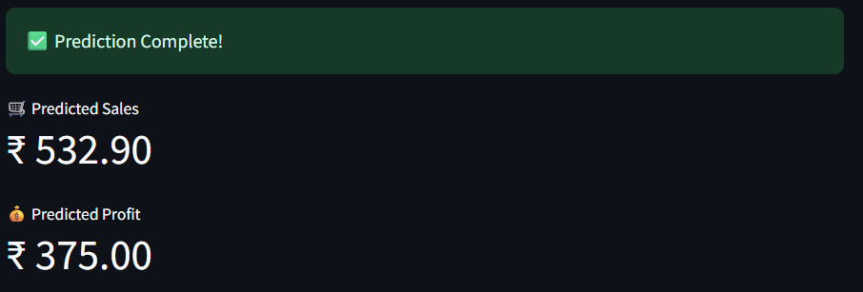
DEPLOYMENT

